Slide 1


Intro to Python
(MESA)

Slide 2


About me
Austin Yen
Second year computer science major at UC Santa Cruz
OHS Alumni (Class of 2019)
Email: ayyen@ucsc.edu

Slide 3

What this is going to be about
Introduction to programming in Python
Understanding basic computer science concepts/fundamentals of programming
Have the ability to write computer programs to solve specified problems
Help considering if you want to go for a CS related pathway
Insight of college CS courses (CSE20)

Slide 4



Software options
Repl.it (Web)
Pycharm (IDE)
VS Code (IDE)
IDE: Integrated Development Environment, software optimized for programming
*Must download python (https://www.python.org/downloads/)

Slide 5
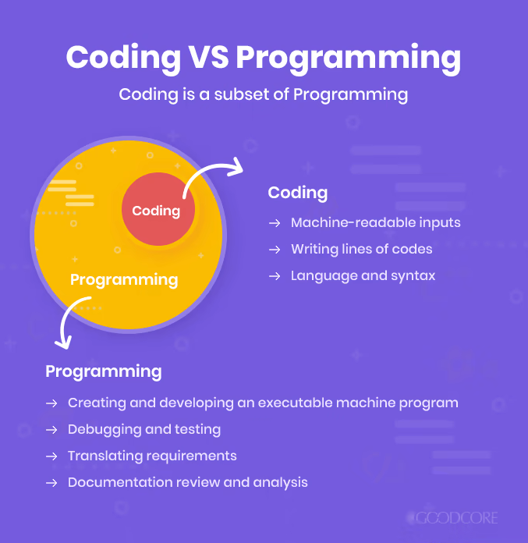
What is Programming?
Programming is a way to tell the computer to perform specific tasks
Ex: arithmetic operations (+-x/), conversions (hex to decimal)

Slide 6
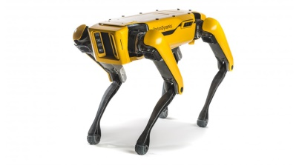

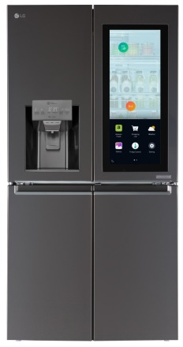

How is it used?
Pretty much everything
Robotics
AI/Machine Learning
Shopping
Home appliances
Game design
Music
Hacking/Cyber Security
And many more!! (Anything you can think of)

Slide 7
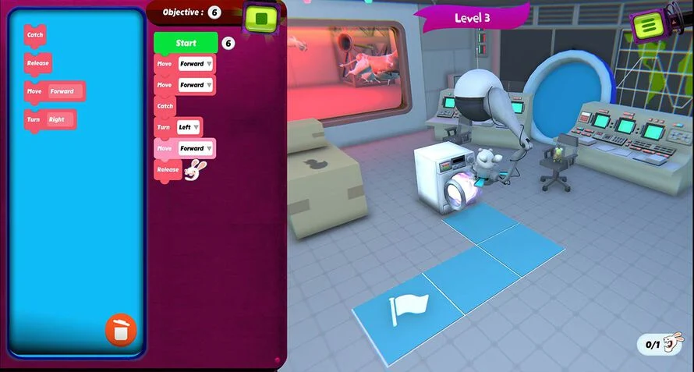
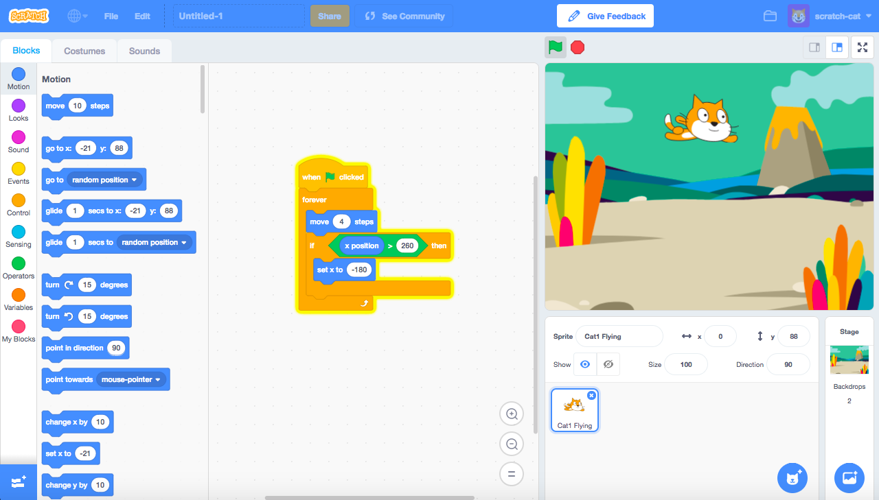
Visualizing code
Block code for those who took CSP
https://studio.code.org/projects/applab/ChAunzyB8mnKTQKf4DNMy_SMQZZBtzdS76moYuumN-0
*Rabbids Coding
*Scratch

Slide 8
Writing your first line of code
Comment
(Doesn’t interfere with code)
#Printing something
print(“Hello world”)
The string value
(Content that’s going to be printed)
Function to print contents that’s inside it

Slide 9
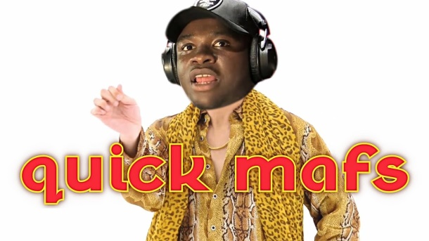
Numbers & Math Operations
Integers: Ex: 1,2,3, 420….
Floats: Ex: 3.1415926, 2.71828183
Add (+)
Subtract (-)
Multiply (*)
Floating point division (/)
Floor division (//)
Modulo/ Remainder (%)
Try them out!
Takes out decimal point, always gives integer

Slide 10
Taking user input
You can assign it to a variable (no need to initialize)
x =input(“What is your name: ”)
print(x)
Function to print x (your input)
You can add values before taking user input
Takes whatever you type into console and set that to variable x

Slide 11
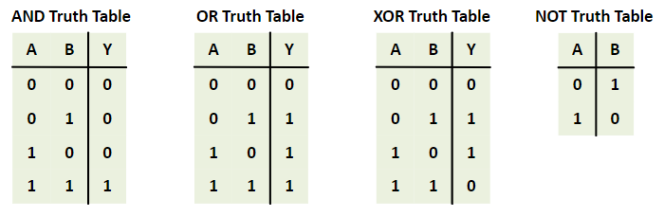
Boolean and inequality
Boolean (True/False)
(and/or/not)
Assignment operator (=) Ex: x=1
Equality operator (==) Ex: 2==2
Greater than (>)
Less than (<)
Not equal (!=)

Slide 12
types
The format of the content
May impose constraints
-ints are whole numbers only
Integer
Float
String
Boolean
NoneType
More will be covered later (dict, list, set..)
What happens if you run the code:
x= 5
y= “Hello”
z= y + x
print(z)

Slide 13
String type
‘Hello’ Single Quote
“Hello” Double Quote
“””Hello””” Triple Double Quote
‘’’Hello’’’ Triple Single Quote
“Hello ‘hi’” Embedding single in double
‘Hello “hi”’ Embedding double in single
What happens if you try:
print(“this is an attempt
to have a string in 2 lines”)
print(‘What’s up’)

Slide 14
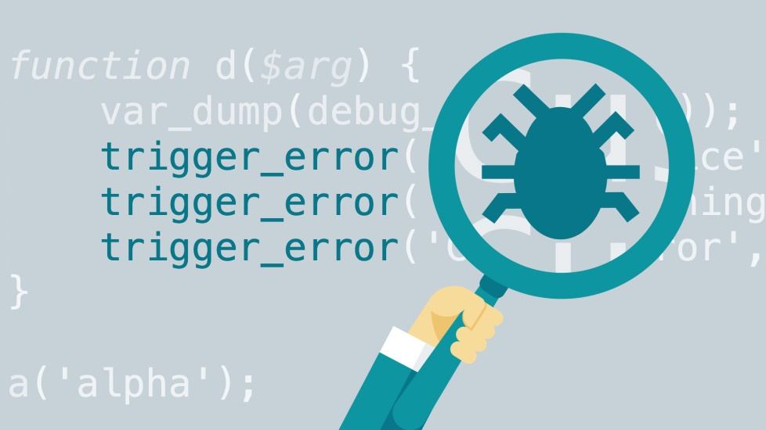
Debugging
Very lengthy but essential process in programming
Checking where went wrong
Try it!
x = 2
y = ‘two’
assert x+y = 4

Slide 15
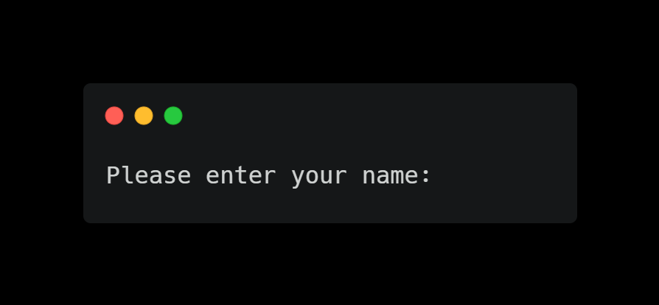
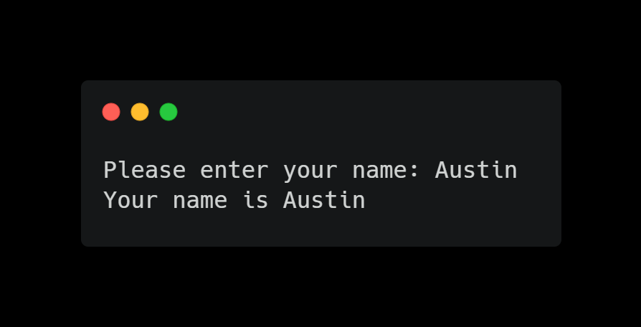
Challenge!!
Create a program to take input and print out your name
Hint: create an input statement and create a variable for it, then print out the string and the variable

Slide 16
Thanks!!
Email: ayyen@ucsc.edu

